Slide 1

GROUP – 4 presentation
Judiciary Information System

Slide 2
119CS0100 | POKALA KUSAL | GROUP 4
119CS0101 | PRIYANSHU KUMAR
119CS0102 | SUSHREE SATARUPA
119CS0103 | NITIN AGARWAL

Slide 3
Table of Contents
01
02
03
04
Problem Statement
Scope
Description of the given problem
Here you could describe the topic of the section
Functional Requirements
Non-Functional Requirements
Specifies all the functionality that the system should support
Here you could describe the topic of the section

Slide 4
Table of Contents
05
06
07
08
UML Diagrams
DFD Diagrams
A Graphical modelling technique used to document object-oriented analysis and design results and independent of any specific design methodology.
DFD is used to modelled and decomposed functional requirements and graphically represents the results of structured analysis.
State Chart Diagram
GUI
Specifies event driven state changes of system
User Interface

Slide 5

01
Problem Statement

Slide 6

Problem Statement
The attorney general’s office has requested us to develop a Judiciary Information System(JIS), to help handle court cases and also to make the past court cases easily accessible to the lawyers and judges.
Each court case is identified by a unique case identification number (CIN) which is generated by the computer. The registrar assigns a date of hearing for each case. Other data maintained about a case include the name of the presiding judge, the public prosecutor, the starting date, and the expected completion date of a trial.
The lawyers and the judges need to refer to the past court cases. It should be possible to search for the history of past court cases by entering key words. However, the lawyers should be charged for each time they see the details of a court case to recover some of the computerization costs.

Slide 7

02
Scope

Slide 8

The problems faced by courts, judiciary and public seeking justice in terms of backlogs, delays and expense are well known or Most of the bottlenecks identified by Judicial Commissions and Committees referring to delays, arrears and backlog be partly overcome if a sound judicial information system is introduced. Case Management, File Management and Docket Management will be vastly improved by resorting to the use of computers. In particular, the following are the areas where use of computer will result in enhanced productivity and reduction of delays 1 ) Generation of Cause List and online statistical reports. 2) Daily List generation with historical data of each case. 3) Word processing with standard templates including generation of notices/processes. 4) Feedback reports for use of various levels.
Scope

Slide 9

• The Judiciary Information System will help handle court cases by maintaining a digital record and data of past cases easily available to the lawyers and judges. • The Court registrar acts as the system administrator and can enter a new case and maintain its details until it’s closed, whereby it is archived and recorded. • The Lawyers and Judges can only browse past cases without modifying any details. • The JIS will provide a common log-in interface to the registrar and all lawyers and judges to access their accounts. • The Judges would be able to browse through the old cases for judgment and to examine the lines of the judgment from similar cases. • It would be possible to search for the history of past court cases by entering keywords. • The Lawyers would be charged for each old case they browse. • The Registrar can see the details of the currently pending cases and the cases which have been resolved or the status of any particular case.

Slide 10

3.Functional Requirements
Specifies all the functionality that the system should support

Slide 11

Log-In :
Registrar :
Register Case :
The Registrar logs in the system and inputs the details of the case.
After the unique CIN is generated, the Registrar assigns a date of hearing for the case. The registrar enters the details of a new case into the system.
Case Summary :
If hearing of a case takes place, the summary of the court proceedings are entered, the judgement is recorded and the case is closed but the details of the case are maintained for future reference. Reason of adjournment is entered if any case is adjourned.
Edit Account :
This function allows the Registrar to create or delete judges/lawyers’ accounts

Slide 12
Registrar :
Query Cases :
Gives the details of the currently pending cases when queried by the Registrar.
Displays the details of the resolved cases over any given period.
Lists the cases due on a particular date.
displays the status (Pending/Closed/Due) of any particular case queried by the Registrar.

Slide 13
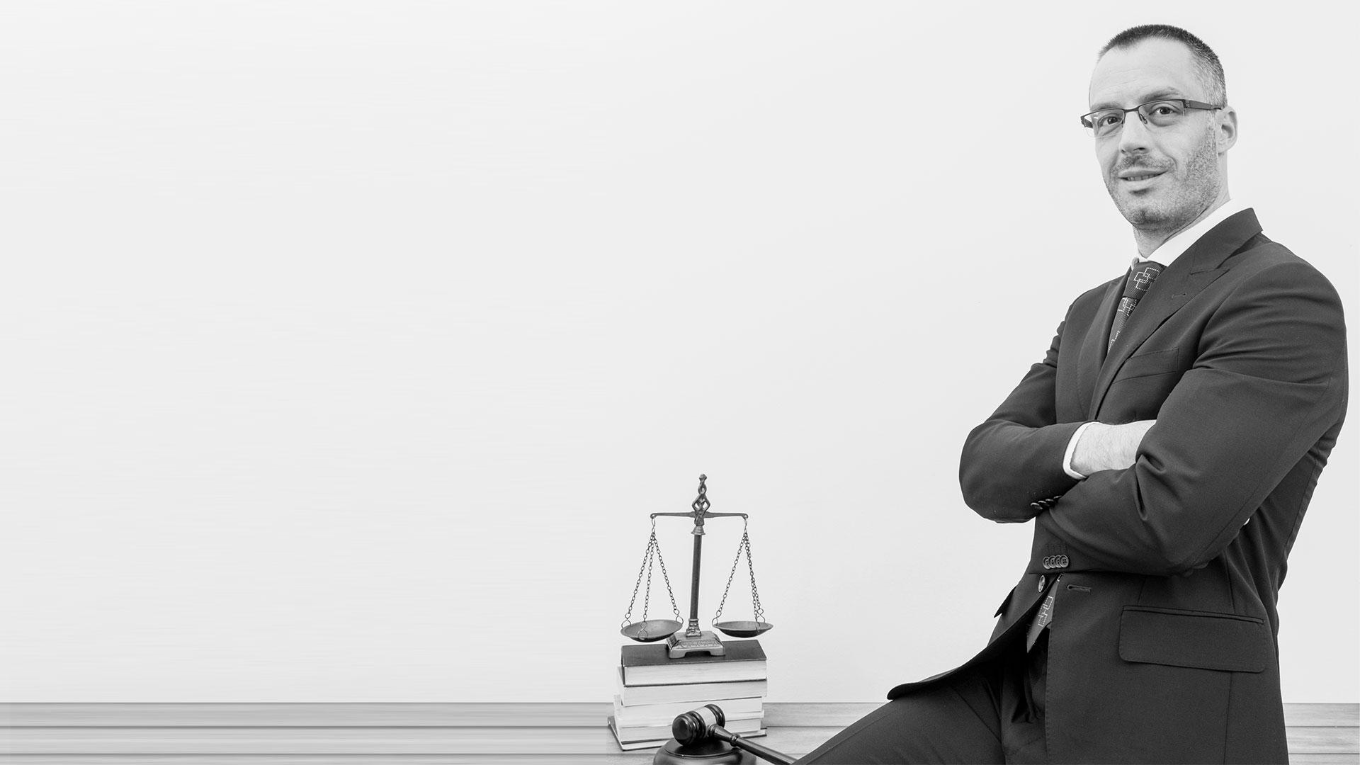
Lawyer
Lawyer Log-In :
Allows the lawyers to log into the JIS and browse through the previous case history to get guidance on similar cases.
Pay Charge:
Allows the lawyers to clear their dues for viewing previous court cases.

Slide 14

Judge
Judge’s Log-In :
Allows the judges to log into the JIS and browse through the previous case history to get guidance on their decisions

Slide 15
4.Non-Functional Requirements
Characteristics of the system which can not be expressed as functions

Slide 16
Non-Functional Requirements
USABILITY:
MAINTAINABILITY:
CORRECTNESS:
The court schedule should satisfy a maximum number of workflow
The Details that are entered should be correct.
The administrators and registrar should maintain correct schedules of court

Slide 17
5.UML Diagrams

Slide 18
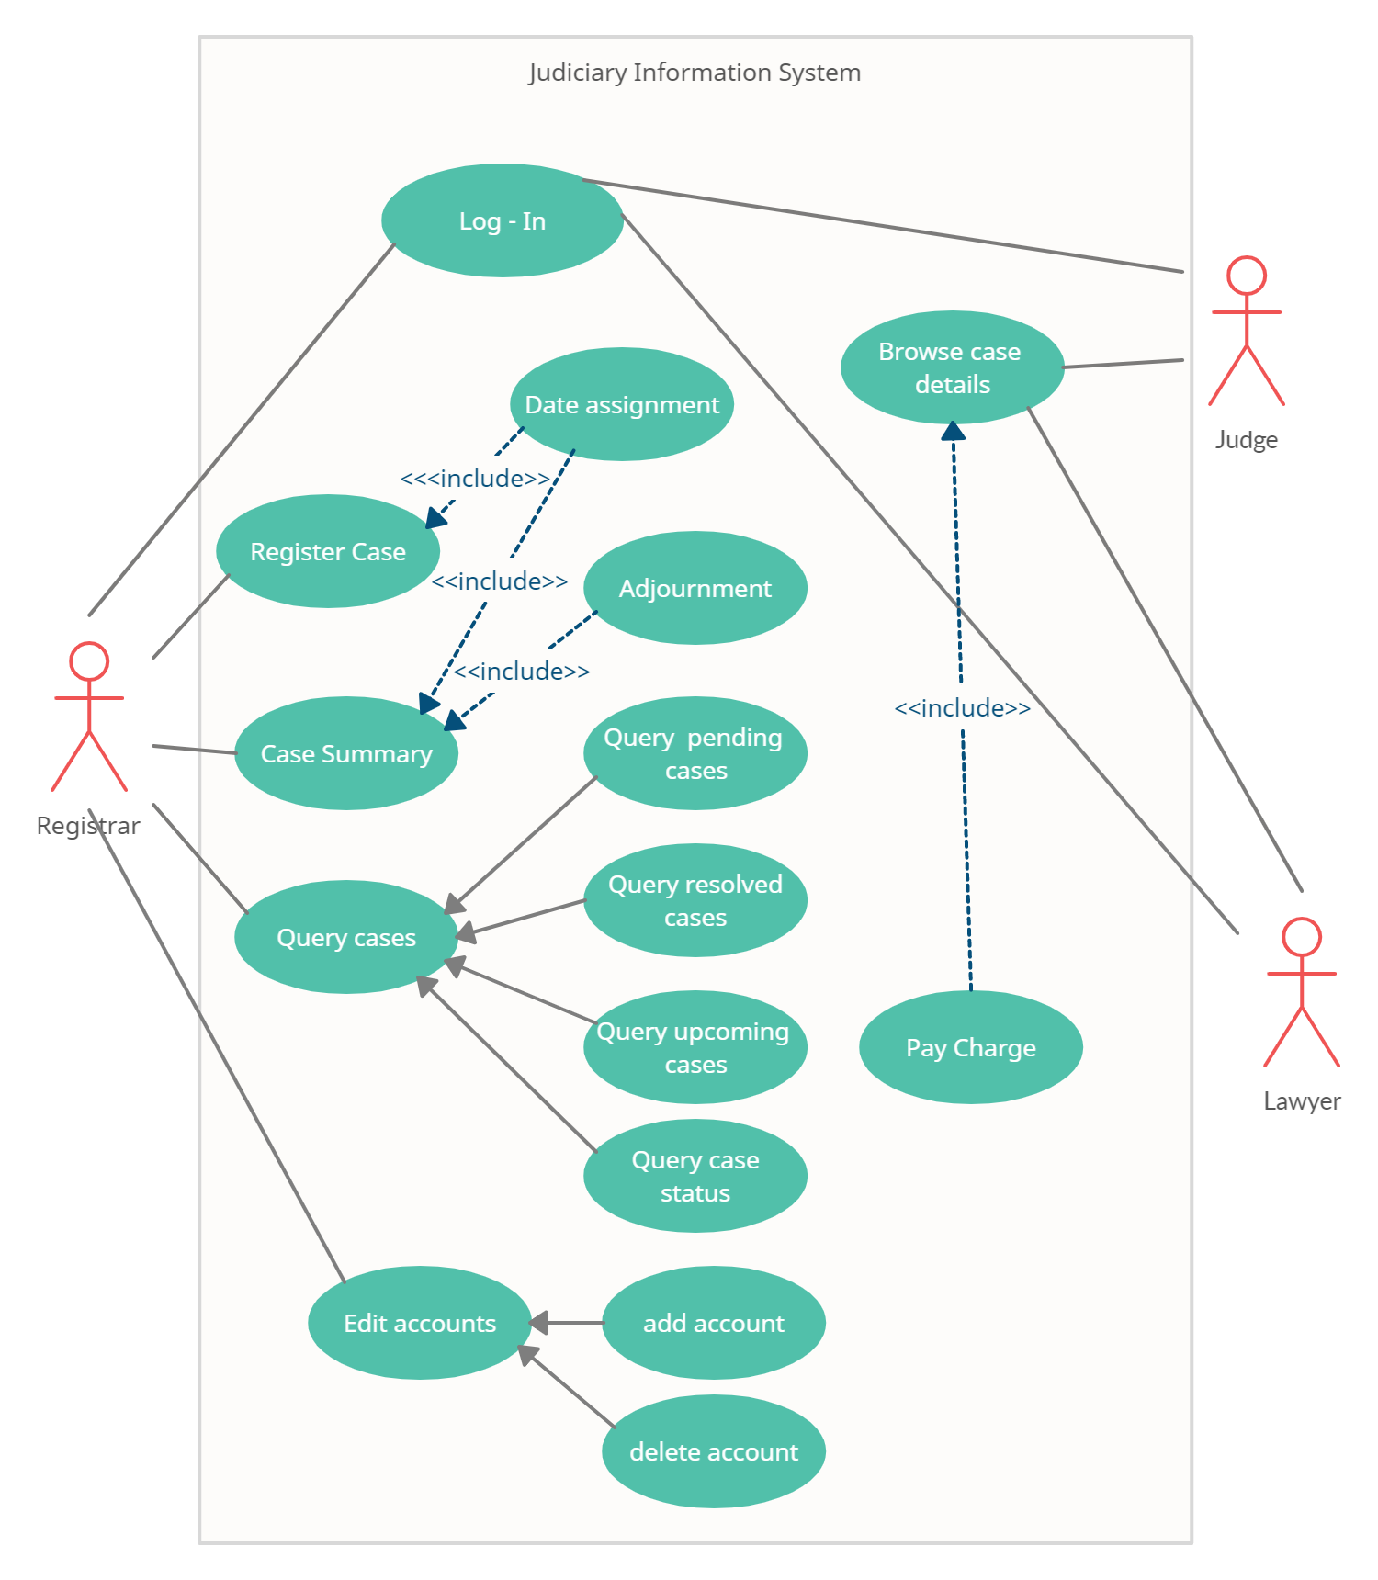
Use Case Diagram
80%
Use case diagram considers scenario as an atomic entity and merely explains its relationships to the system and the user.
Realization of use cases is outside this model element
Group E

Slide 19
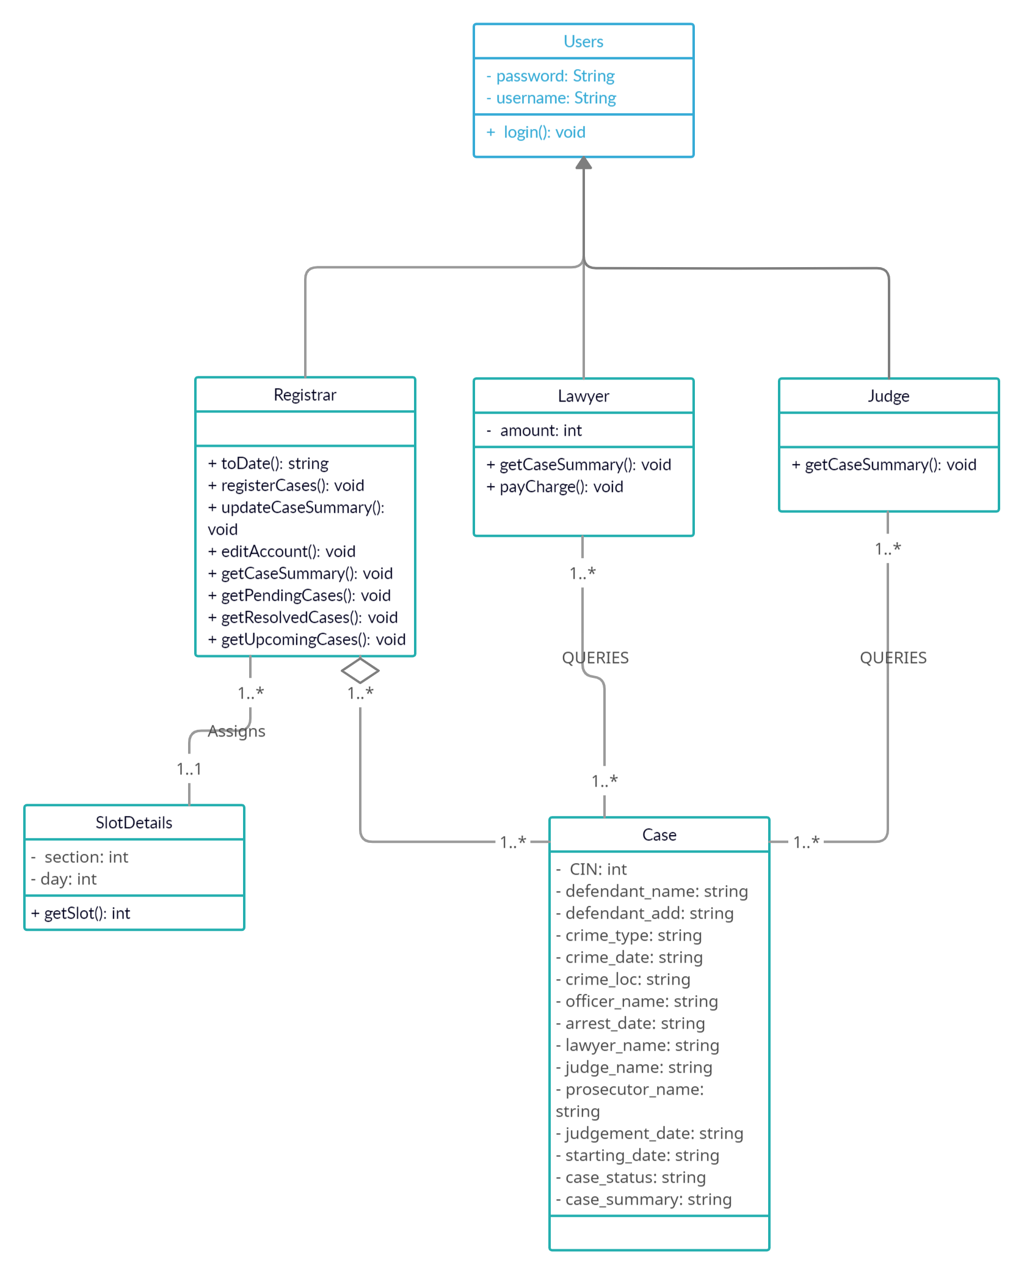
Class Diagram
A class diagram shows the existence of classes and their relationships in the logical view of a system

Slide 20
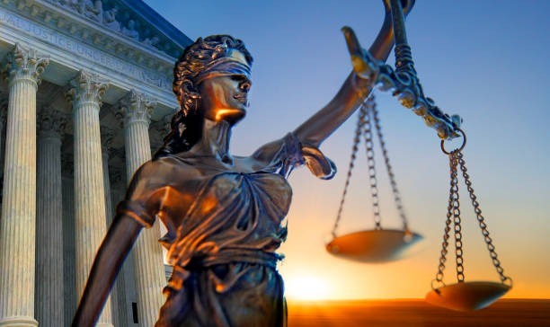
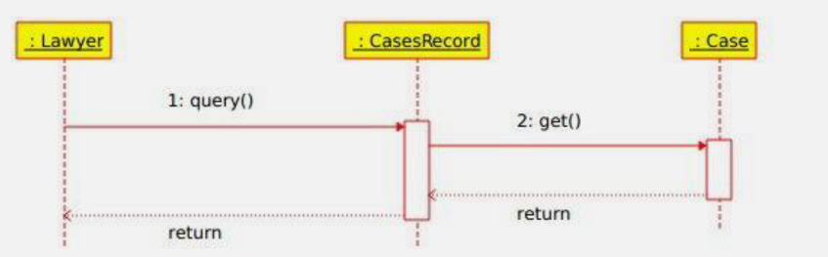
Lawyer’s Sequence Diagram

Slide 21
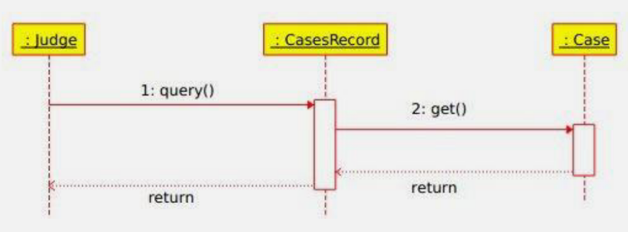
Judge’s Sequence Diagram

Slide 22
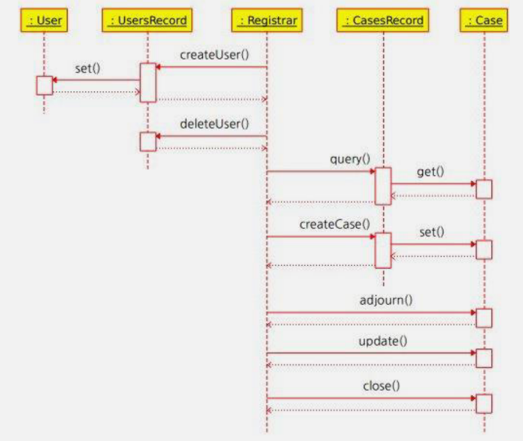
registrar’s Sequence Diagram

Slide 23
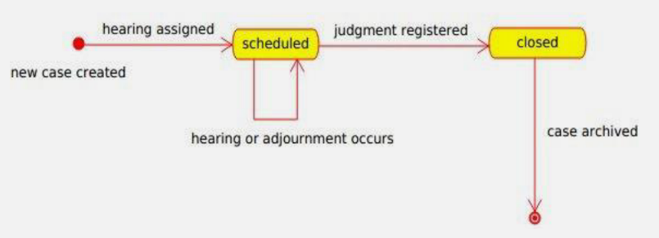
State chart diagram

Slide 24
6.DFD Diagrams

Slide 25
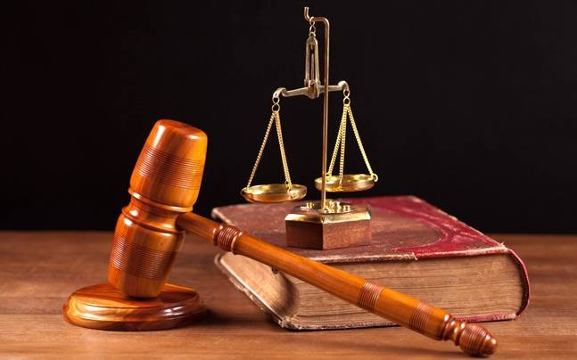
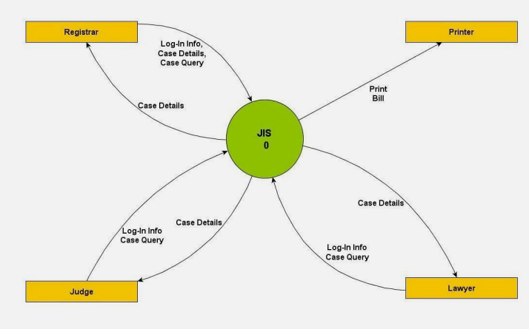
DFD Level 0

Slide 26
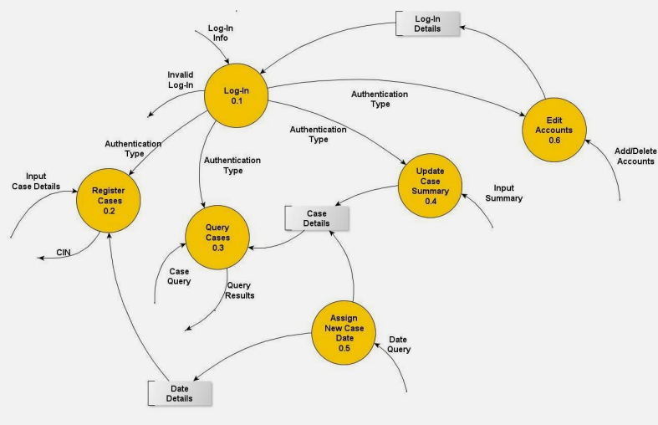
DFD Level 1

Slide 27
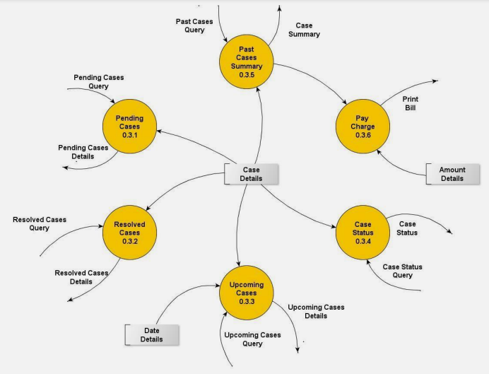
DFD Level 2

Slide 28
7.State Chart Diagram

Slide 29
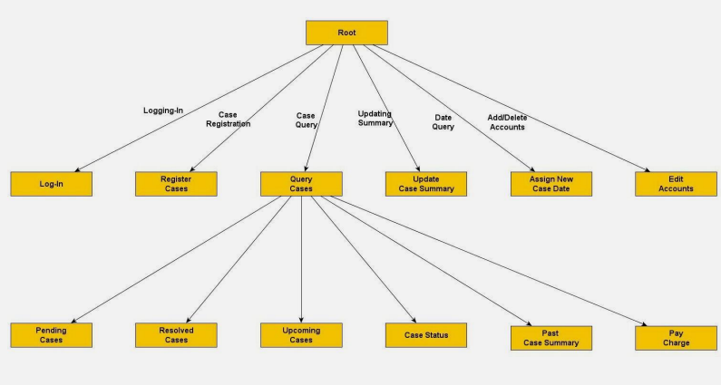
Structure chart

Slide 30
8.GUI

Slide 31
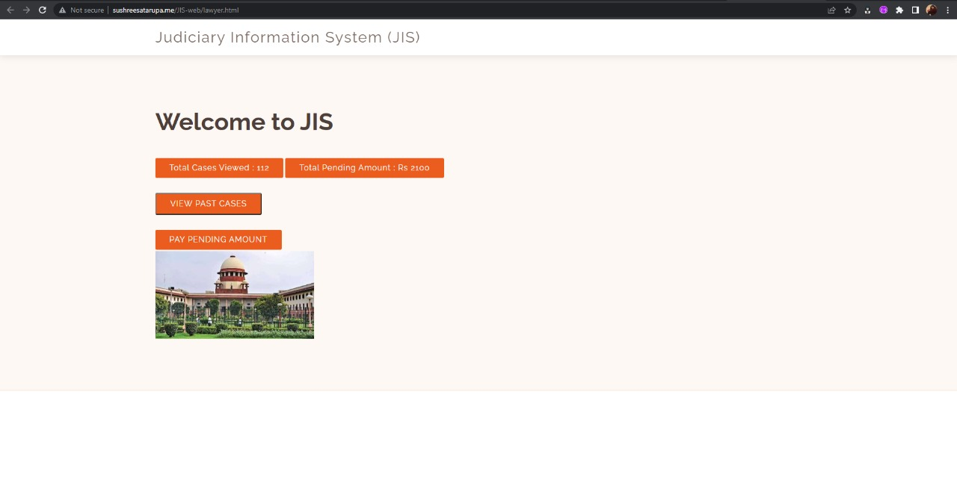

Slide 32
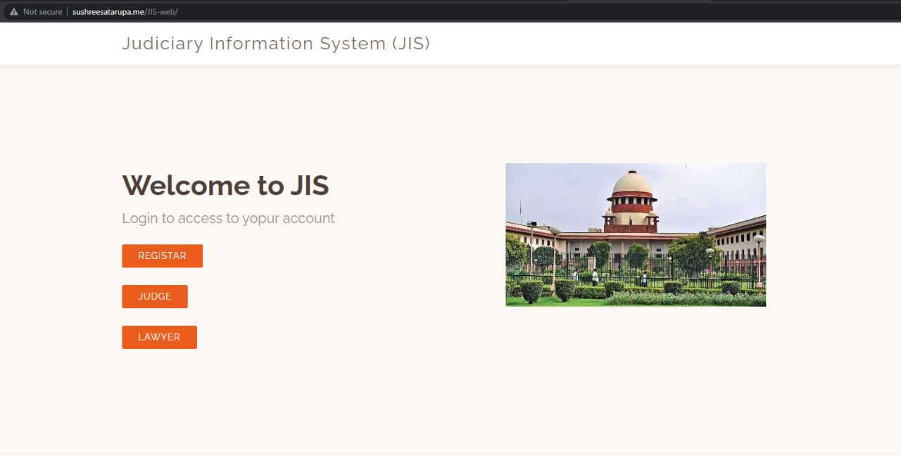
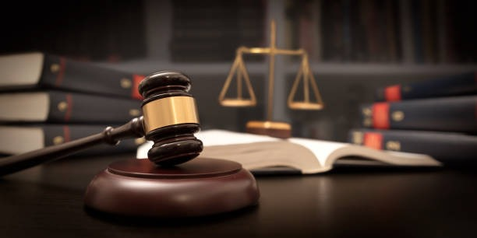

Slide 33
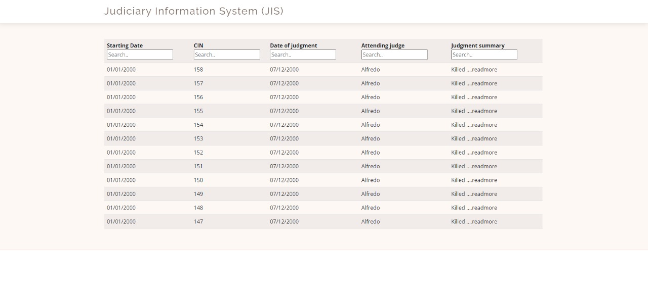

Slide 34
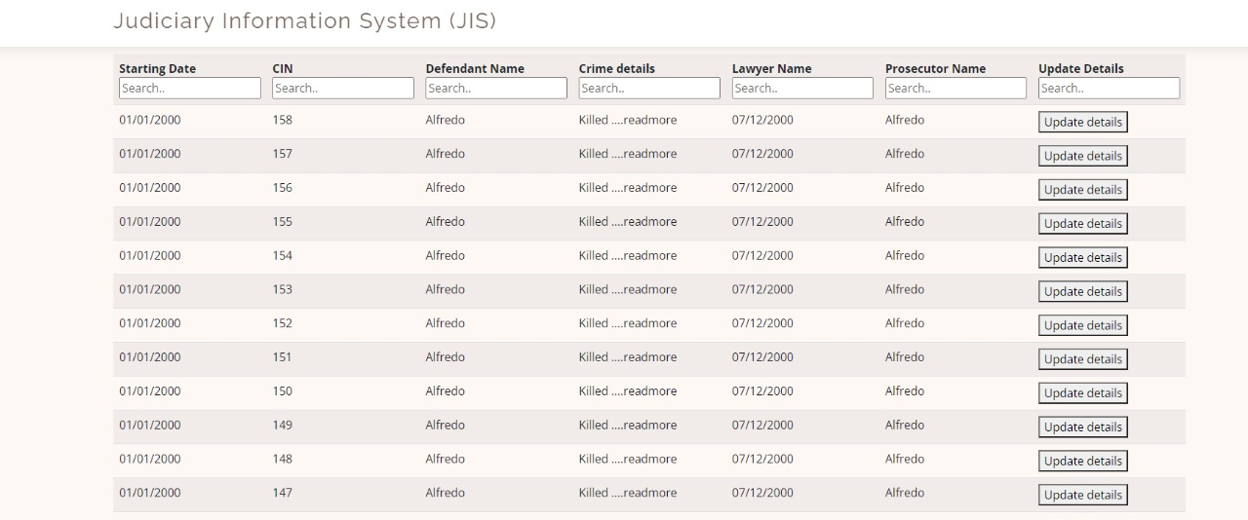

Slide 35
Thank
You

